Slide 1
6
INFINITE SEQUENCES AND SERIES
Copyright © Cengage Learning. All rights reserved.

Slide 2
6.1
Infinite Sequences
Copyright © Cengage Learning. All rights reserved.

Slide 3



Sequences
An infinite sequence or (sequence for short) can be thought of as a list of numbers written in a definite order:
a₁, a₂, a₃, a₄, . . . , a_{n}, . . .
The number a₁ is called the first term, a₂ is the second term, and in general a_{n} is the nth term. We will deal exclusively with infinite sequences and so each term a_{n} will have a successor a_{n+1}.
Notation: The sequence {a₁, a₂, a₃, . . .} is also denoted
by

Slide 4
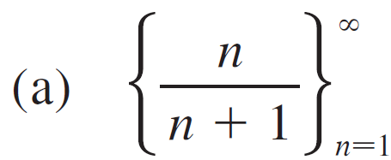
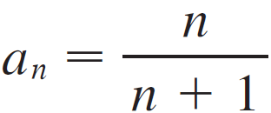
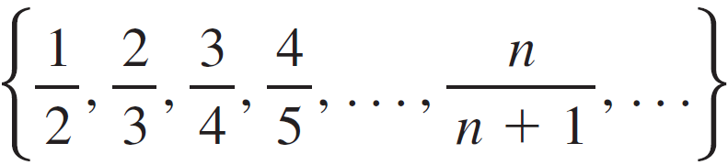
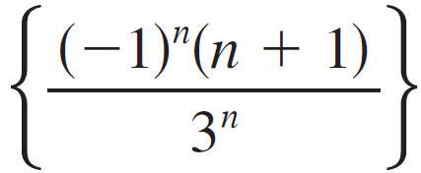
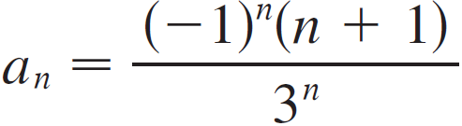
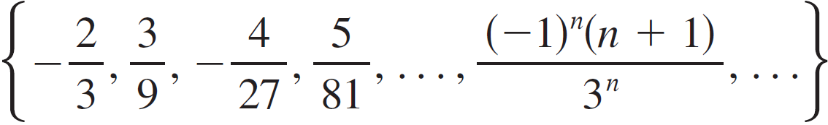
Example 1
Some sequences can be defined by giving a formula for the
nth term. In the following examples we give three descriptions of the sequence: one by using the preceding notation, another by using the defining formula, and a third by writing out the terms of the sequence. Notice that n doesn’t have to start at 1.
(a)
(b)

Slide 5



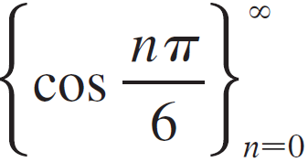
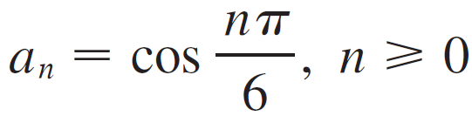
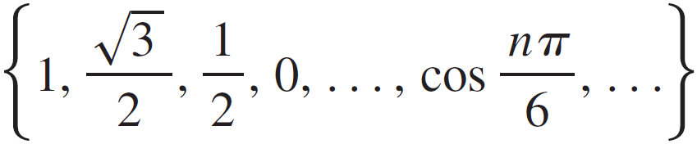
Example 1
cont’d
(c)
(d)

Slide 6

Sequences
The Fibonacci sequence {f_{n}} is defined recursively by the conditions
Each term is the sum of the two preceding terms. The first few terms are

Slide 7
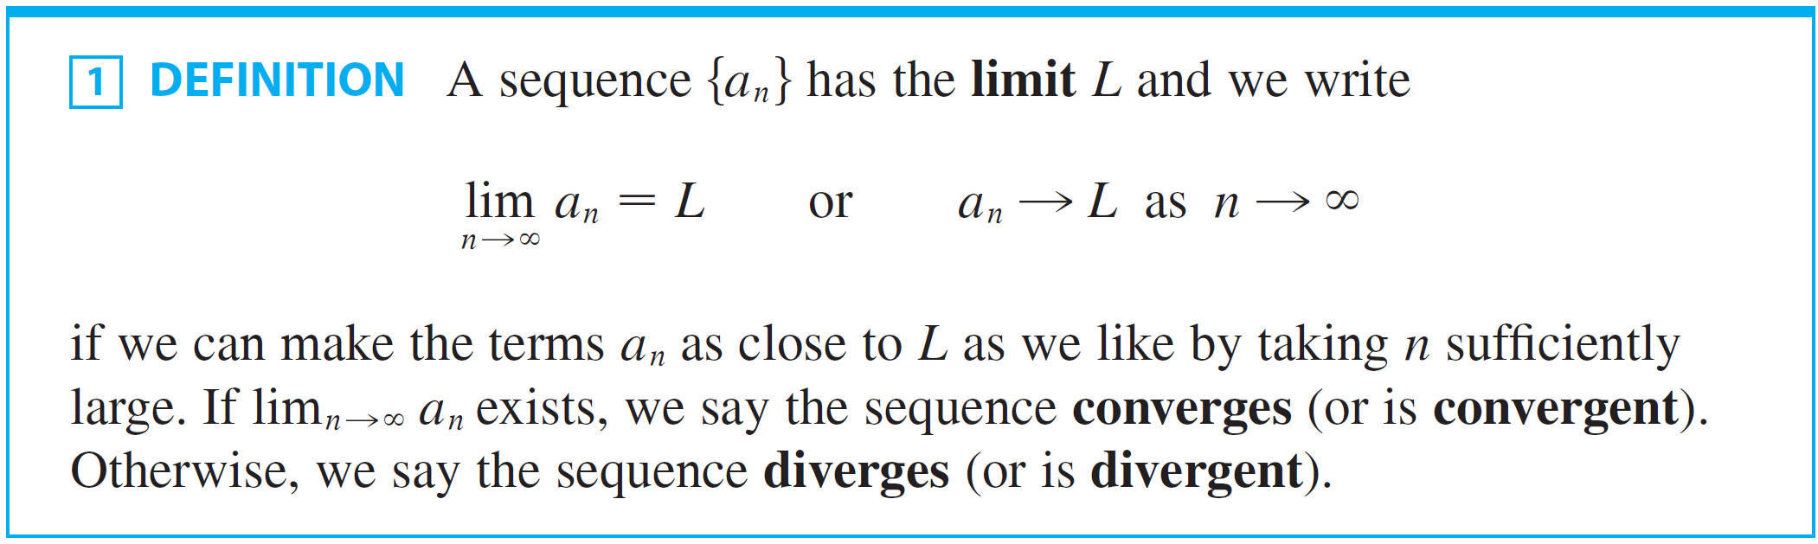
Sequences
Following is the definition of the limit of a sequence:

Slide 8
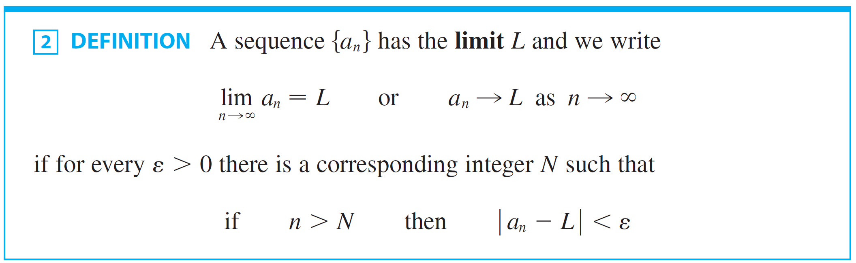
Sequences
A more precise version of Definition 1 is as follows.

Slide 9
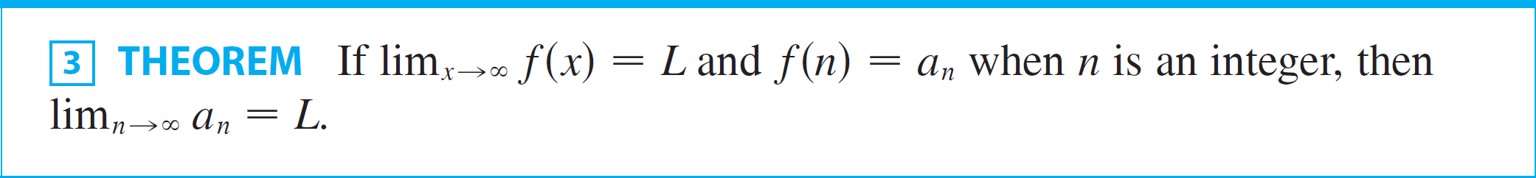
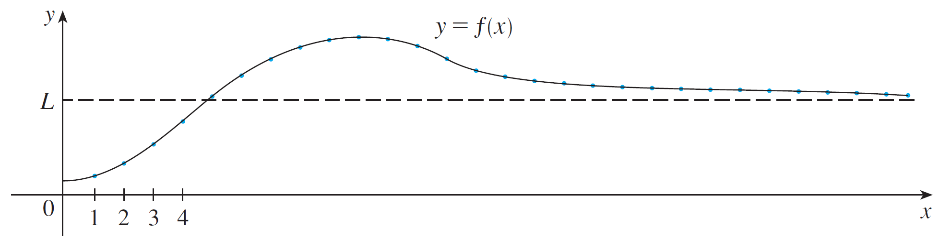
Sequences
We have the following theorem, which is illustrated by Figure 6.
Figure 6

Slide 10

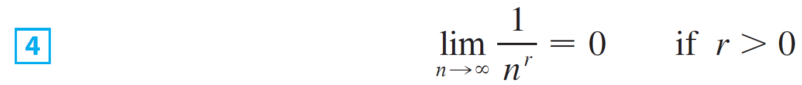

Sequences
In particular, since we know that
when r > 0, we have
If a_{n} becomes large as n becomes large, we use the notation

Slide 11
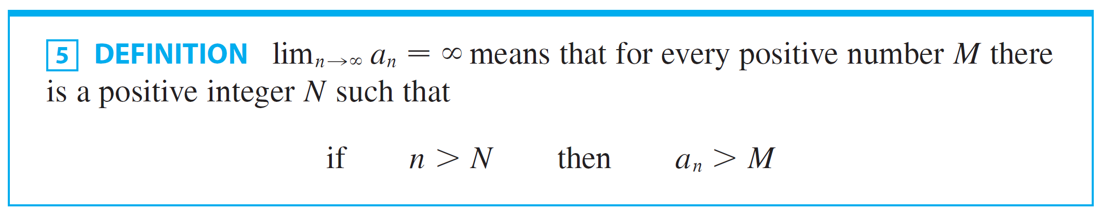


Sequences
The following is a precise Definition.
If then the sequence {a_{n}} is divergent but in a special way. We say that {a_{n}} diverges to .

Slide 12
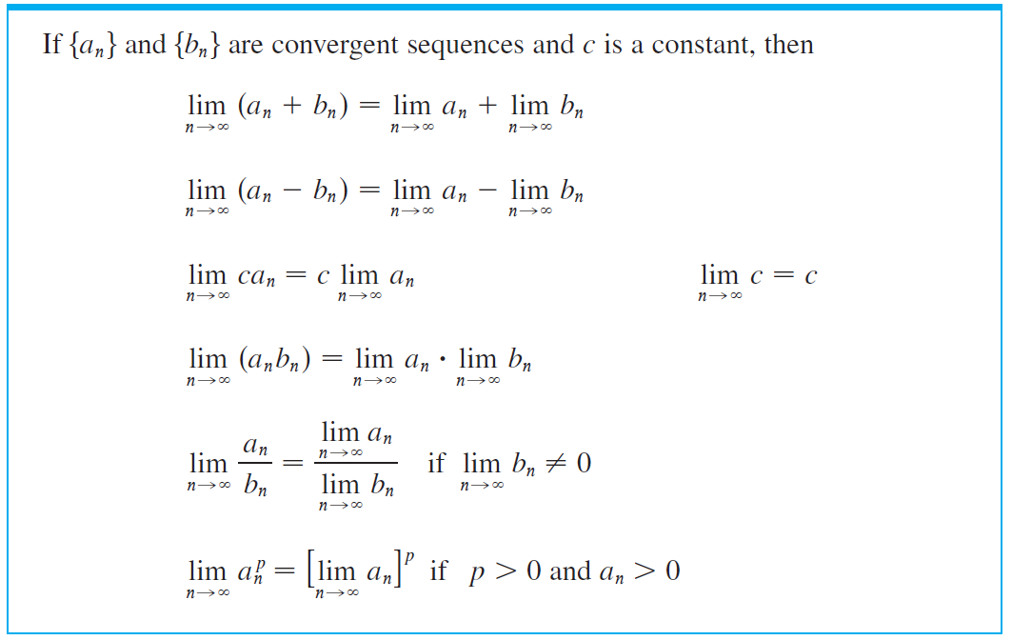
Sequences
Following is the Limit Laws for Sequences.

Slide 13
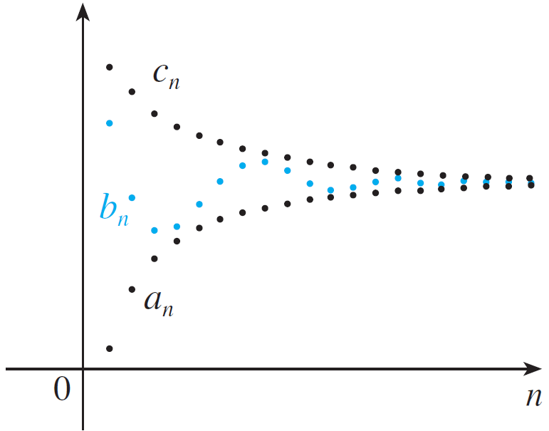
Sequences
The Squeeze Theorem can also be adapted for sequences
as follows (see Figure 7).
The sequence {b_{n}} is squeezed between the sequences {a_{n}} and {c_{n}}.
Figure 7

Slide 14
Sequences
Another useful fact about limits of sequences is given by the following theorem:

Slide 15
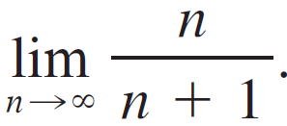
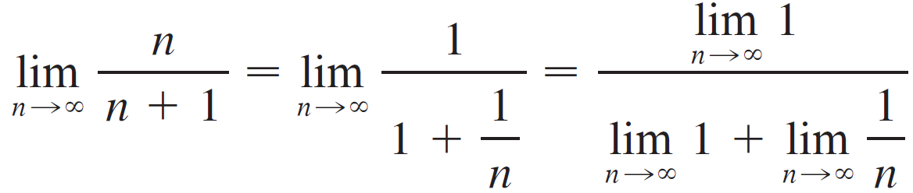
Example 4
Find
Solution:
Divide numerator and denominator by the highest power of n that occurs in the denominator and then use the Limit Laws.

Slide 16
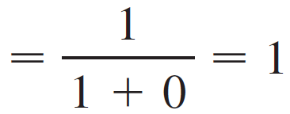
Example 4 – Solution
cont’d
Here we used Equation 4 with r = 1.

Slide 17
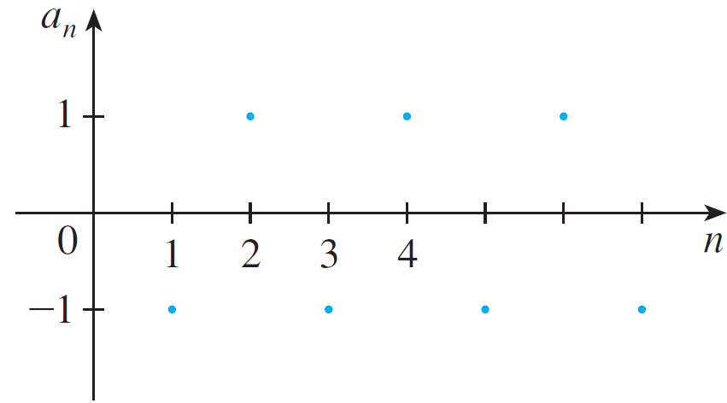
Example 6
Determine whether the sequence a_{n} = (–1)^{n} is convergent or divergent.
Solution:
If we write out the terms of the sequence, we obtain
{–1, 1, –1, 1, –1, 1, –1, . . .}
The graph of this sequence
is shown in Figure 8.
Figure 8

Slide 18

Example 6 – Solution
cont’d
Since the terms oscillate between 1 and –1 infinitely often, a_{n} does not approach any number.
Thus does not exist; that is, the sequence
{(–1)^{n}} is divergent.

Slide 19
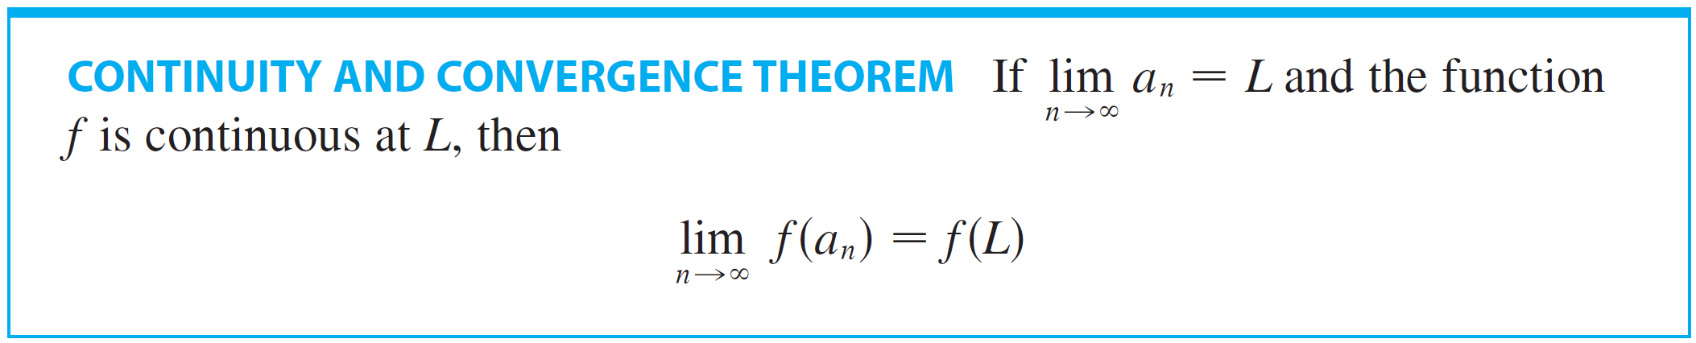
Sequences
The following theorem says that if we apply a continuous function to the terms of a convergent sequence, the result is also convergent.

Slide 20


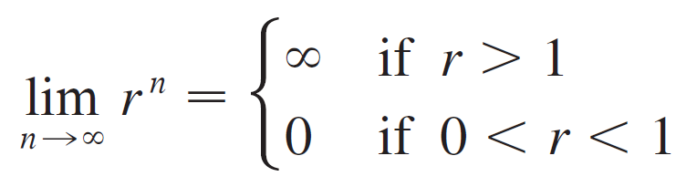
Example 10
For what values of r is the sequence {r ^{n} } convergent?
Solution:
We know that for a > 1 and for
0 < a < 1.
Therefore, putting a = r and using Theorem 3, we have

Slide 21
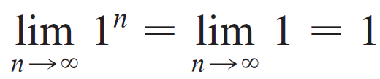




Example 10 – Solution
cont’d
For the cases r = 1 and r = 0 we have
and therefore by Theorem 6.
If r ≤ –1, then {r^{n}} diverges.

Slide 22
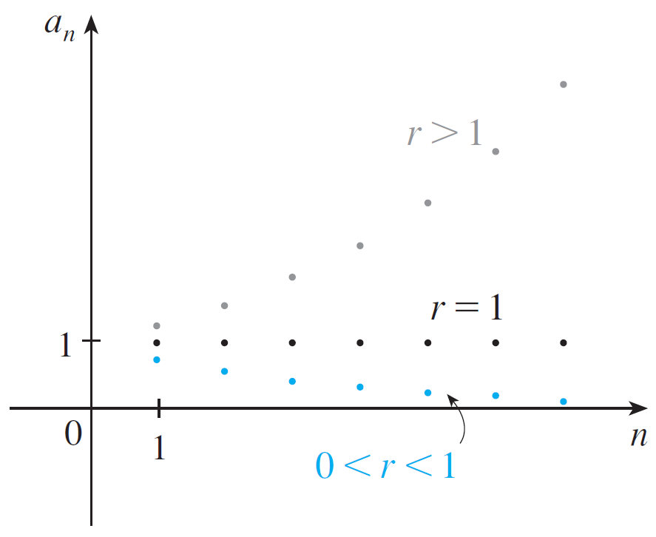
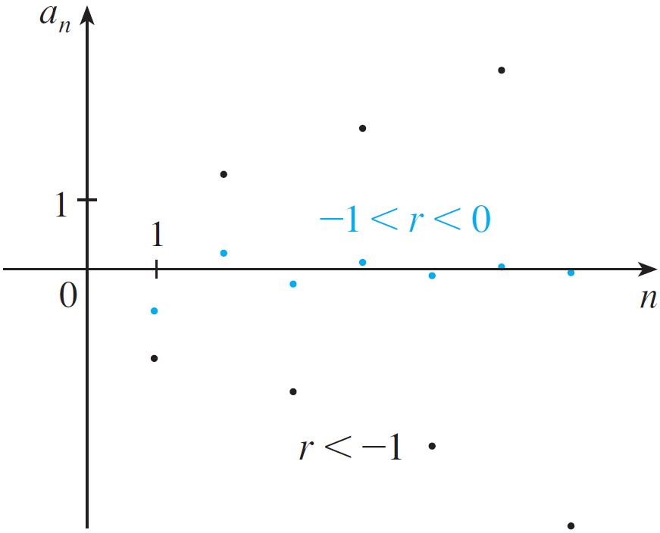
Example 10 – Solution
cont’d
Figure 11 shows the graphs for various values of r. (The case r = –1 is shown in Figure 8.)
The sequence a_{n} = r^{n}
Figure 11

Slide 23
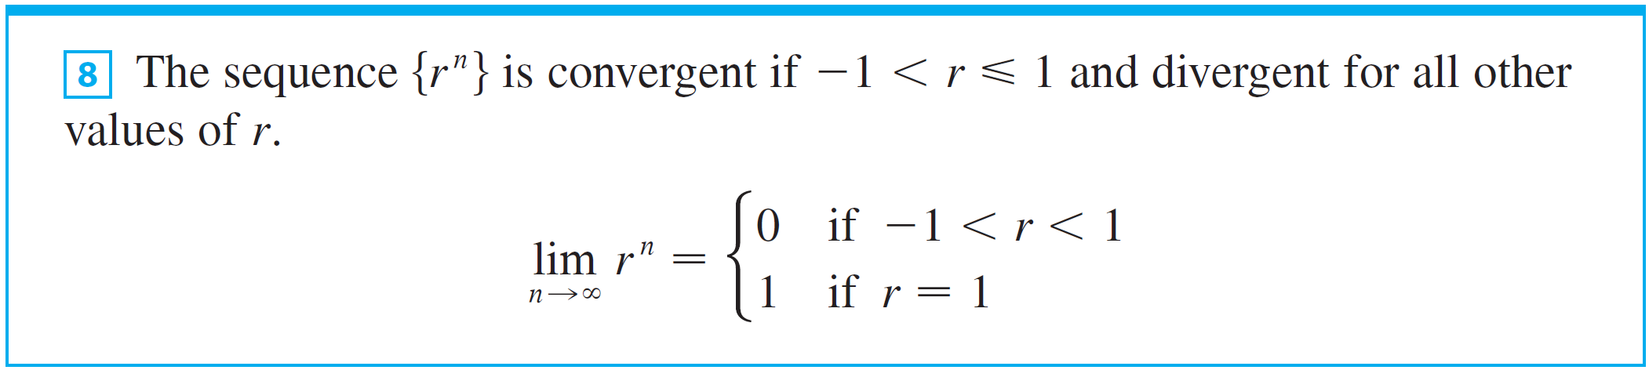
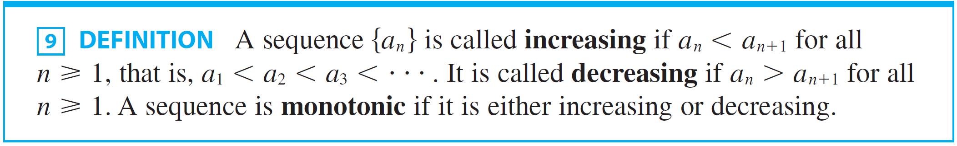
Sequences
The results of Example 10 are summarized for future use as follows.

Slide 24
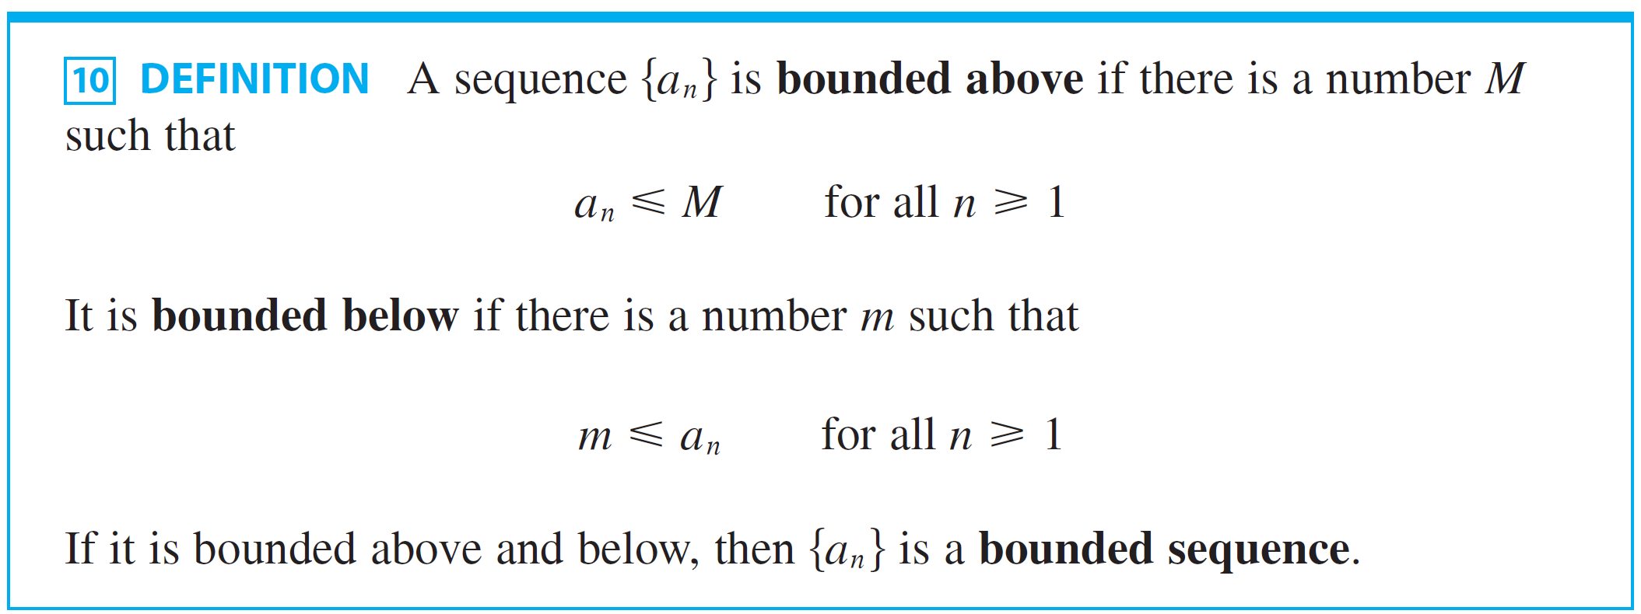
Sequences
Following is the definition of bounded sequence.

Slide 25

Sequences
For instance, the sequence a_{n} = n is bounded below
(a_{n} > 0) but not above. The sequence a_{n} = n/(n + 1) is bounded because 0 < a_{n} < 1 for all n.
We know that not every bounded sequence is convergent and not every monotonic sequence is convergent
But if a sequence is both bounded and monotonic, then it must be convergent.

Slide 26
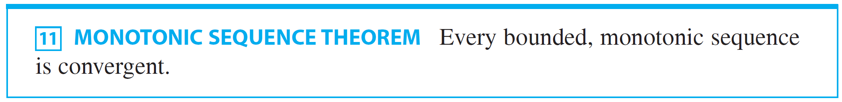
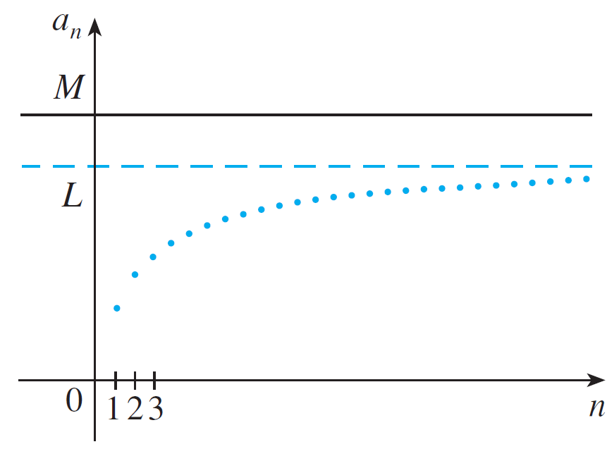
Sequences
This fact is given by Theorem 11, but intuitively you can understand why it is true by looking at Figure 12.
Figure 12

Slide 27

Sequences
If {a_{n}} is increasing and a_{n} ≤ M for all n, then the terms are forced to crowd together and approach some number L.
Theorem 11 is based on the Completeness Axiom for the set of real numbers, which says that if S is a nonempty set of real numbers that has an upper bound M (x ≤ M for all x in S), then S has a least upper bound b.
(This means that b is an upper bound for S, but if M is any other upper bound, then b ≤ M.)

Slide 28
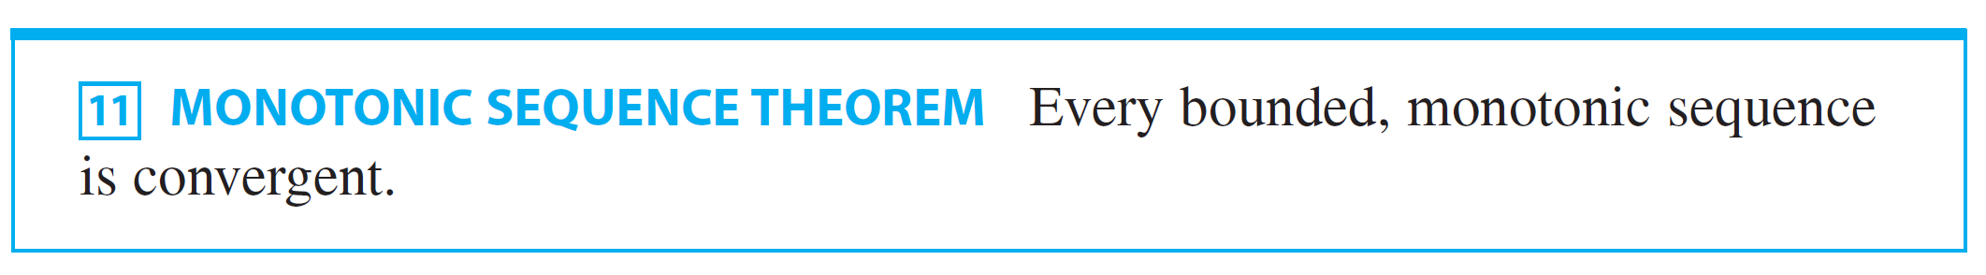
Sequences
The Completeness Axiom is an expression of the fact that there is no gap or hole in the real number line.

